Slide 1
Linear Algebra
YANG Jiankui
School of Science, BUPT
E-Mail: yangjk@amss.ac.cn
Notes:
Linear Algebra Class 1
W.B.Zhang@hotmail.com

Slide 2
Some rules for our class
Please take notes
Do not disturb others (so turn off your cell-phones)
If you are late, just come in and join us
Ask questions as soon as possible
Do homework by yourself
Hand up your homework in time

Slide 3
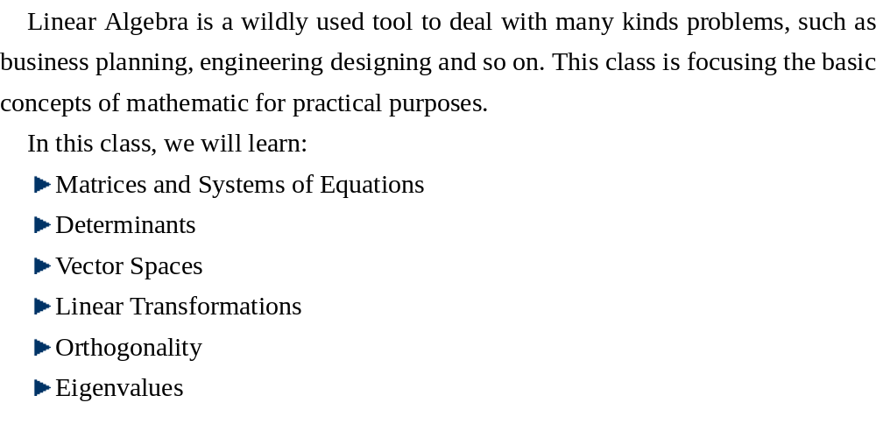
Overview of this class

Slide 4
Chapter 1
Matrices and Systems of Equations

Slide 5
Lecture 1
Systems of Linear Equations

Slide 6
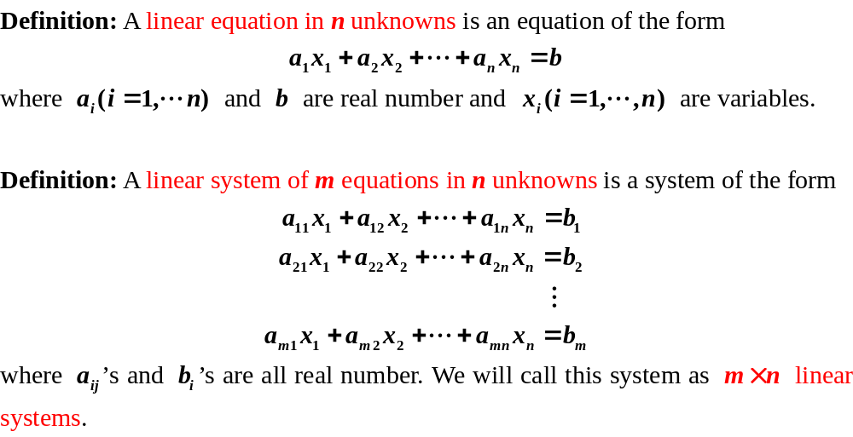
Systems of Linear Equations

Slide 7
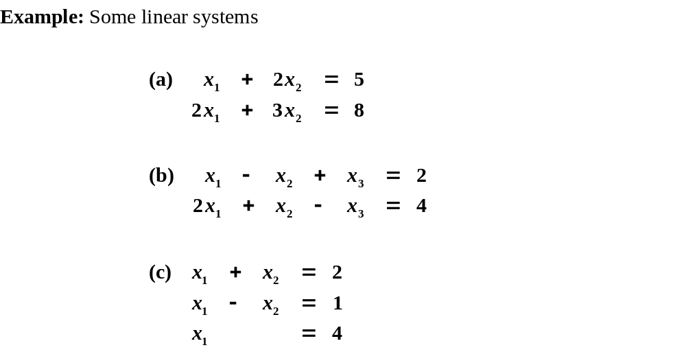
Systems of Linear Equations
Can you solve these systems?
Who want to be a volunteer?
Notes:
Linear Algebra Class 1
W.B.Zhang@hotmail.com
System (a) is 2×2 system, (b) is 2×3 system and (c) is 3×2 system.
Find some volunteers to solve system (a), (b) or even (c).

Slide 8
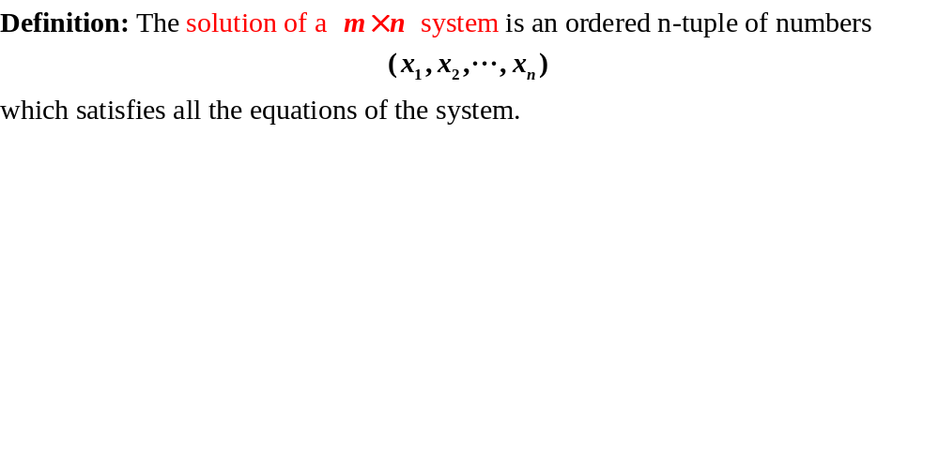
Systems of Linear Equations

Slide 9
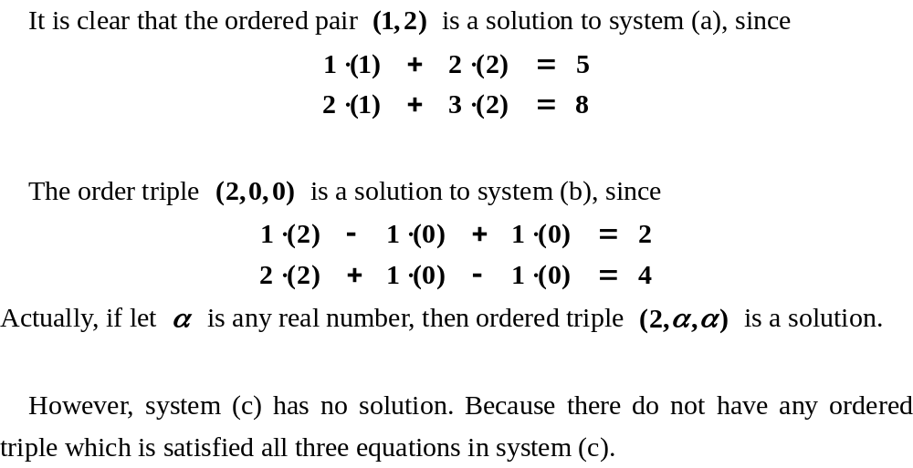
Systems of Linear Equations

Slide 10
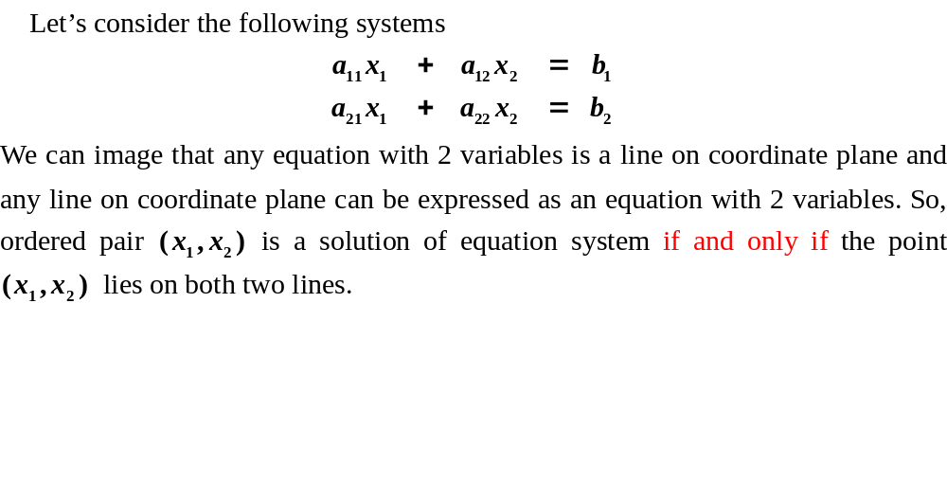




2×2 Systems
if and only if
Notes:
Linear Algebra Class 1
W.B.Zhang@hotmail.com
The relationship is if and only if

Slide 11
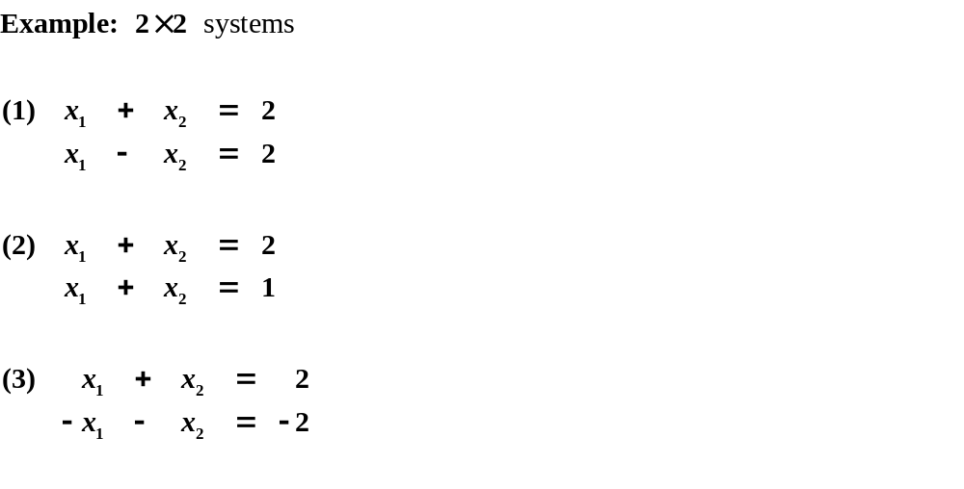



2×2 Systems

Slide 12
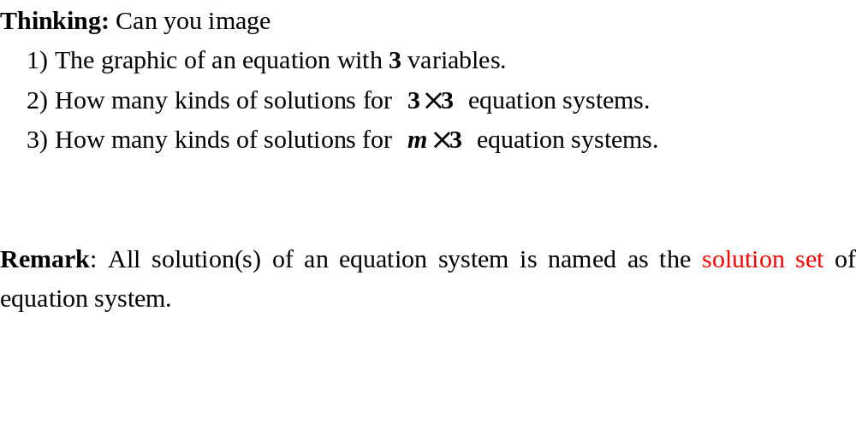



2×2 Systems
?

Slide 13
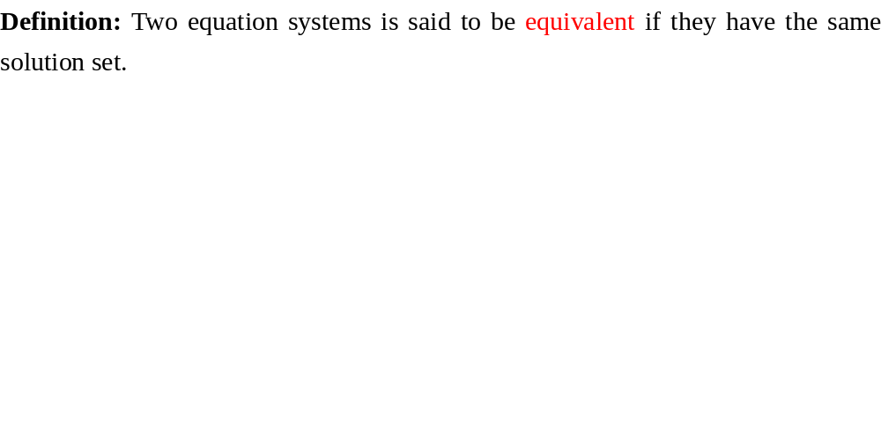
Equivalent System

Slide 14
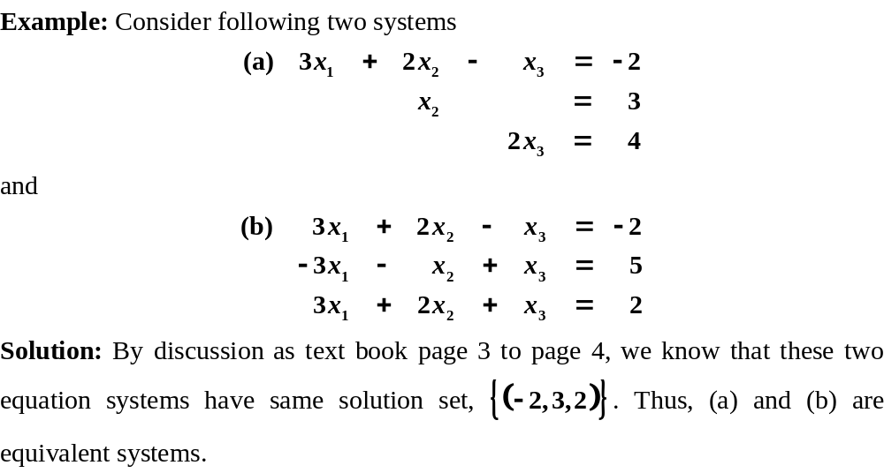
Equivalent System

Slide 15
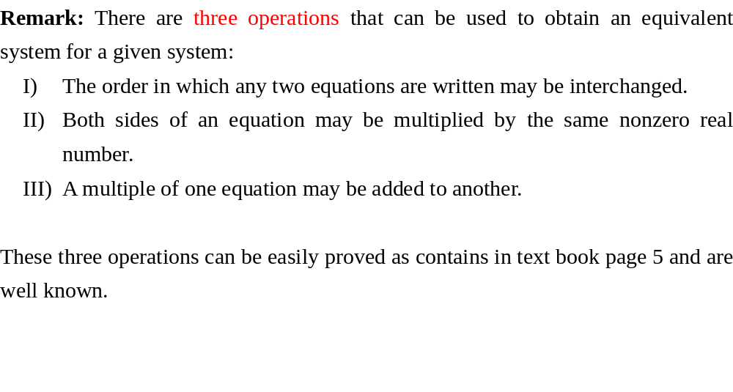
Equivalent System

Slide 16
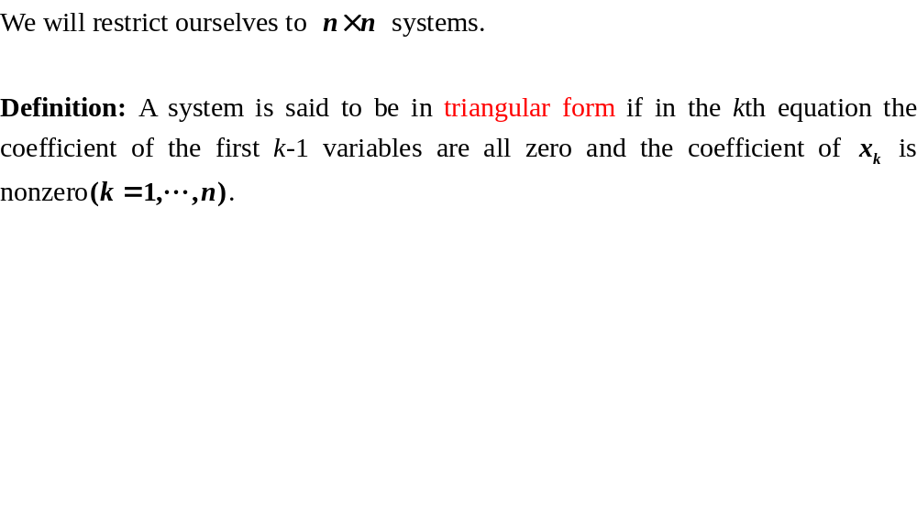
n×n Systems
Notes:
Linear Algebra Class 1
W.B.Zhang@hotmail.com
We will restrict ourselves to n×n systems for the remainder of this section, We will show that if an n×n system has exactly one solution, through row operation I and III, it can be changed to an equivalent “triangular system”.

Slide 17
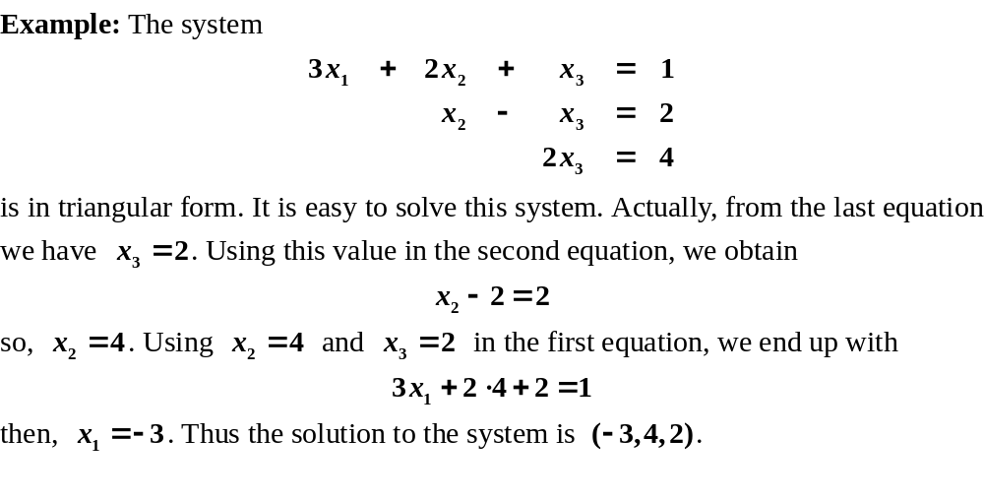
n×n Systems

Slide 18
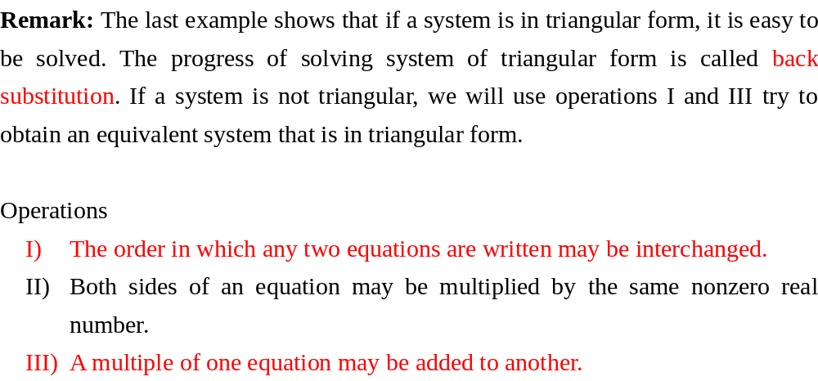
n×n Systems

Slide 19
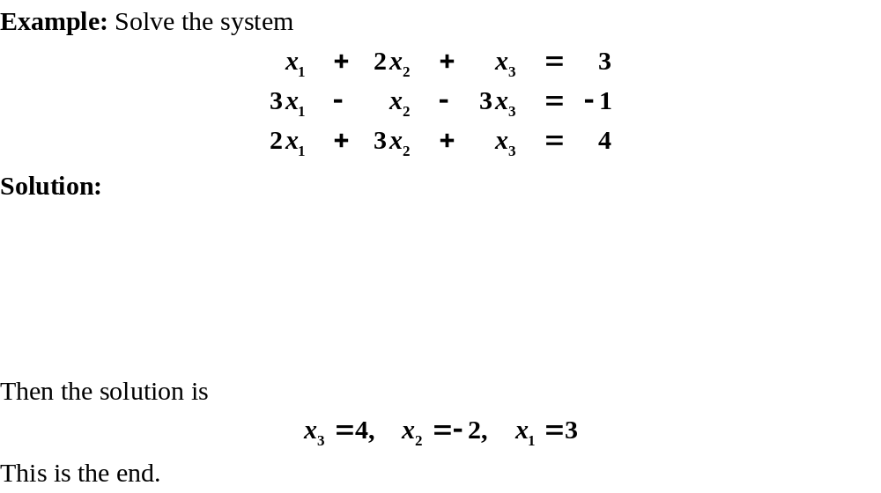
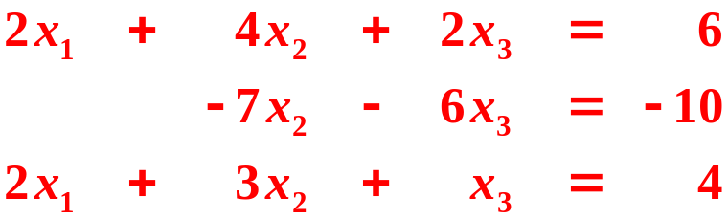

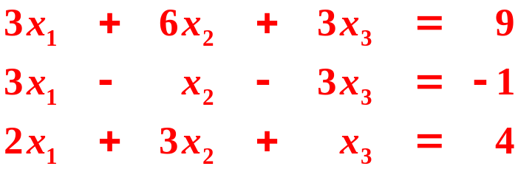

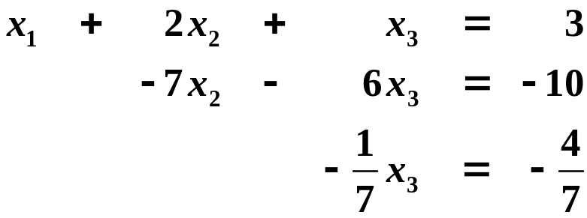
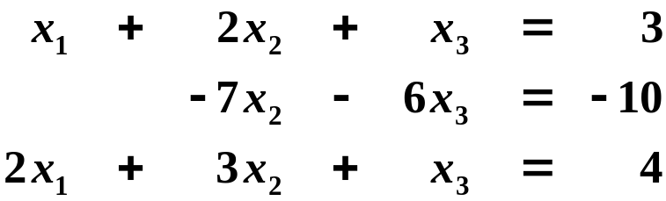
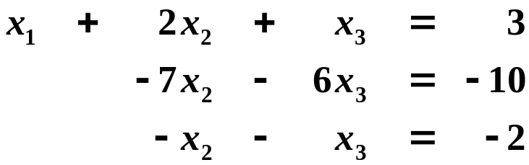
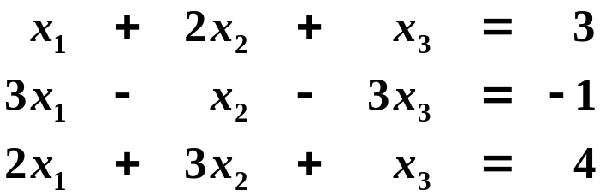

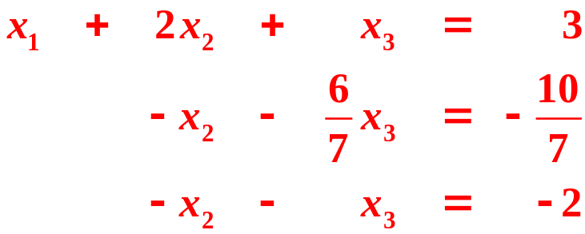
n×n Systems

Slide 20
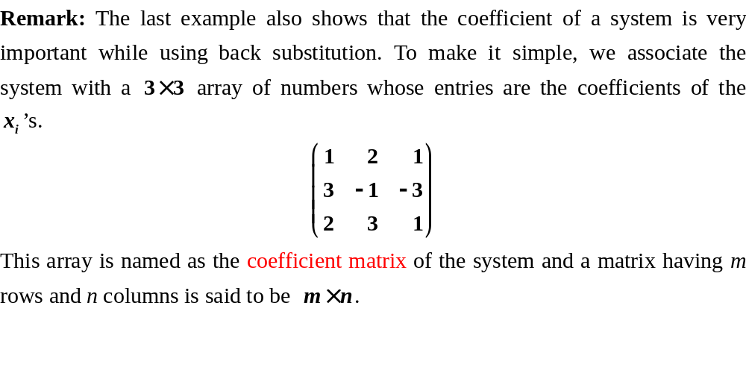
n×n Systems

Slide 21
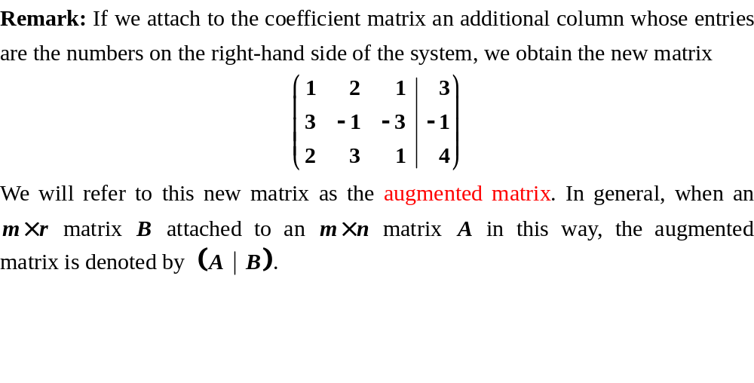
n×n Systems

Slide 22
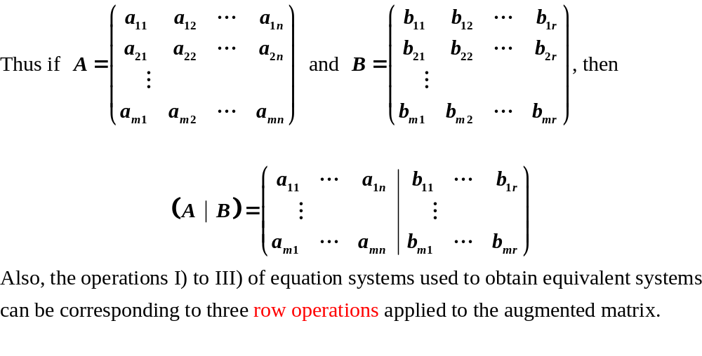
n×n Systems

Slide 23
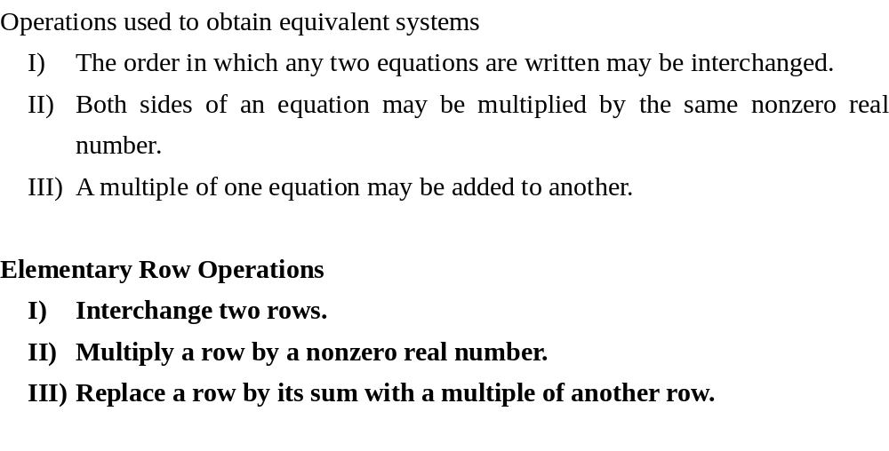
n×n Systems

Slide 24
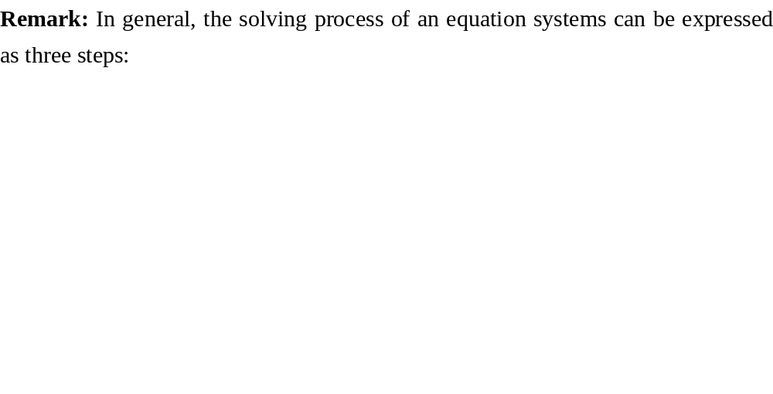
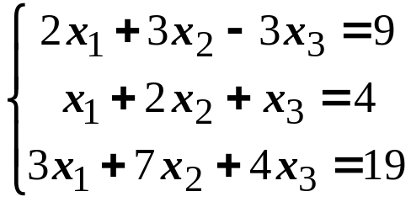
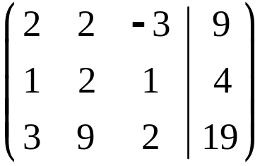

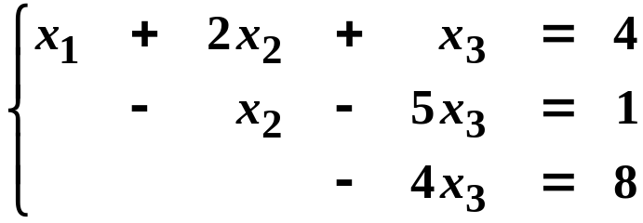
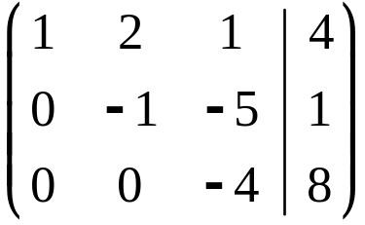

n×n Systems
Equivalent Systems
Elementary Row Operations

Slide 25
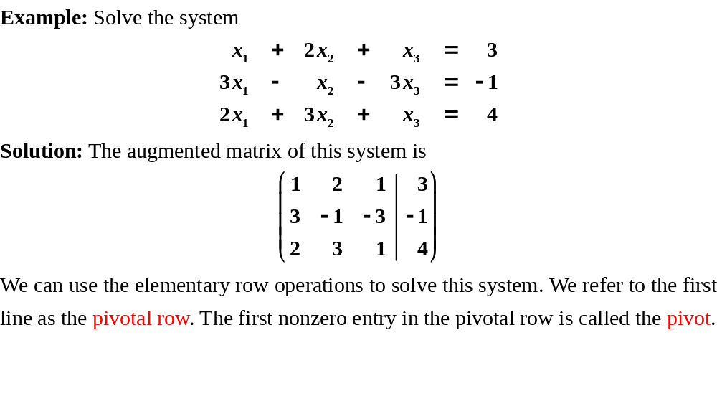
n×n Systems
Notes:
Linear Algebra Class 1
W.B.Zhang@hotmail.com
Recall the last example

Slide 26
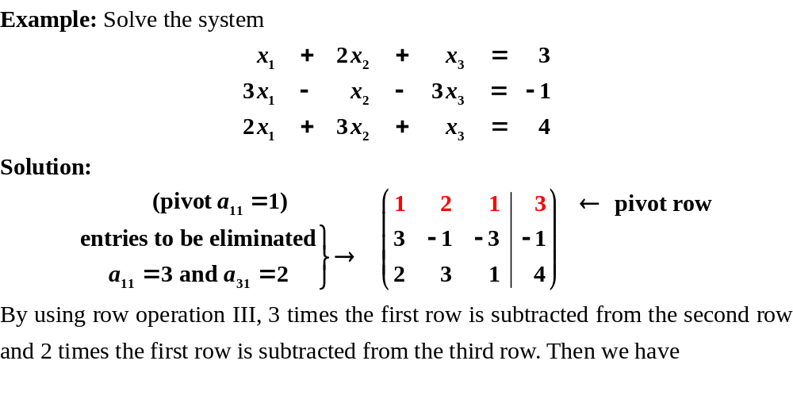
n×n Systems

Slide 27
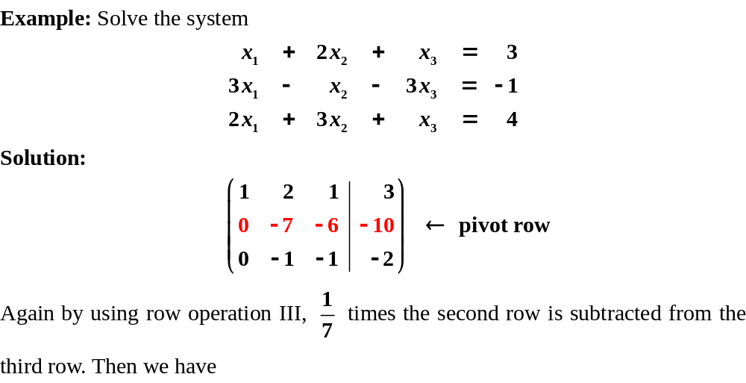
n×n Systems

Slide 28
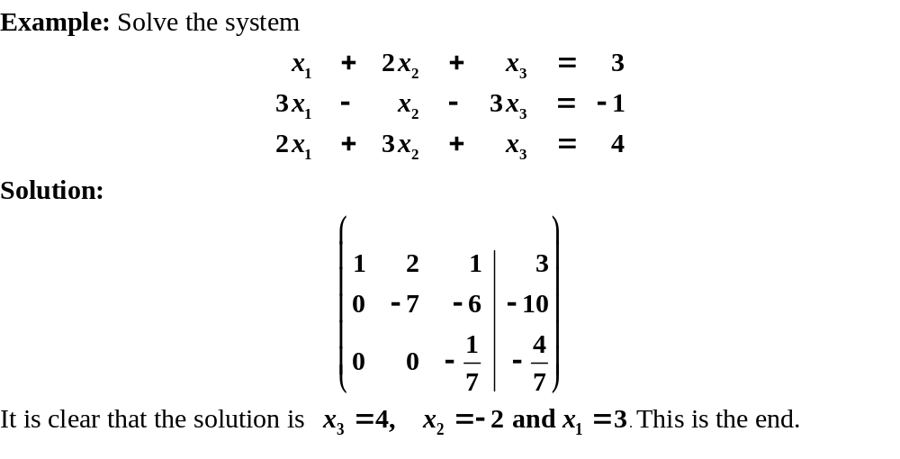
n×n Systems

Slide 29
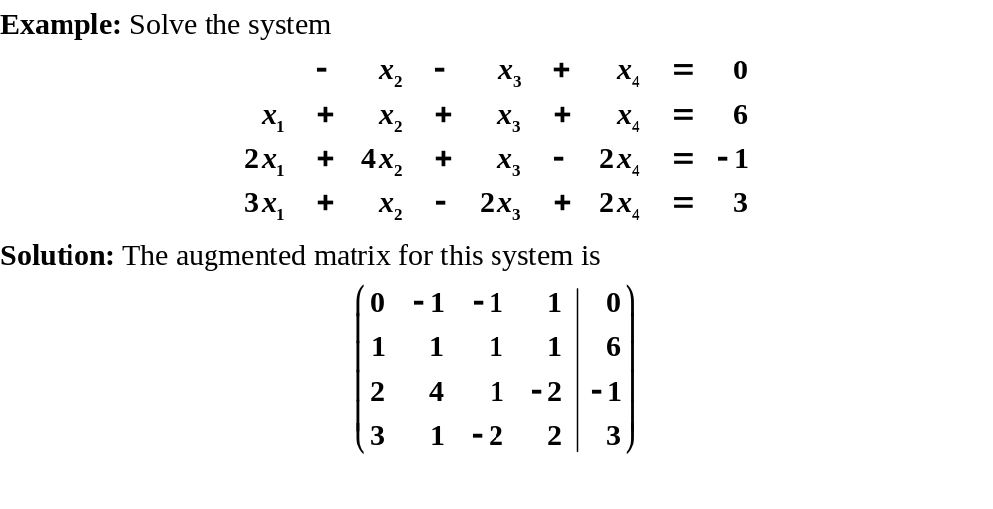
n×n Systems
Since 0 can not eliminate
any entry. So, we will use
operation I to interchange
the first two rows and the
pivot element will be 1

Slide 30
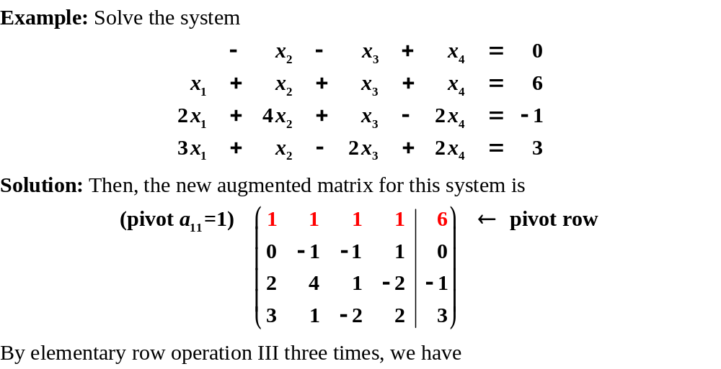
n×n Systems

Slide 31
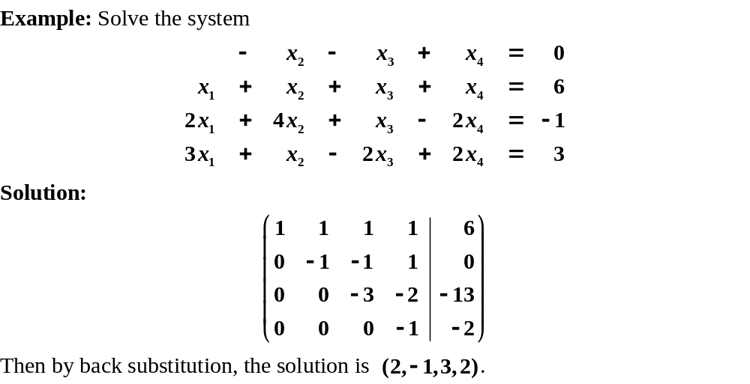
n×n Systems

Slide 32
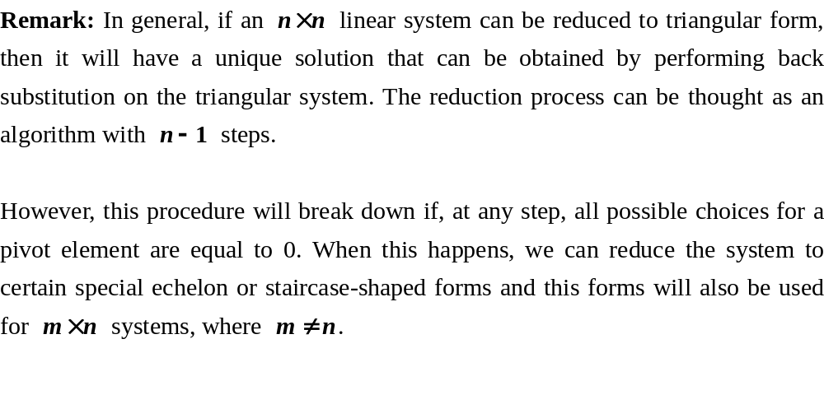
n×n Systems

Slide 33
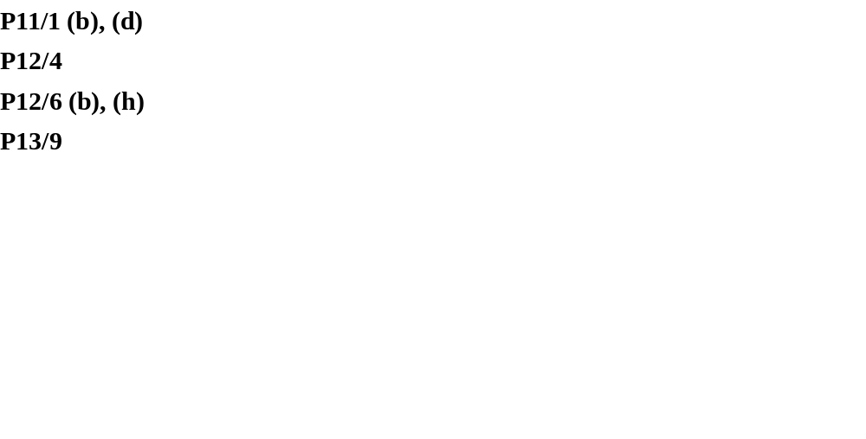
Exercises

